Slide 1
Mapping Amdocs Portfolio to eTOM level 2
Contacts:
Corporate: Sigal Almog
Foundation: Gil Trotino, Alon Gayego
Customer Mngt: Collette Yee
Revenue Mngt: Rotem Ron Katzir
Service & Resource Mngt: Kfir Dan-Ari
Content: Shira Gottlieb
Latest version can be found under:
Sales Central > Industry Information > Industry Forums >
Amdocs Portfolio Mapping To eTOM 6 Level 2
Full Coverage
Partial Coverage

Slide 2

ASOM and BPI Methodology
© 2004 - Proprietary and Confidential Information of Amdocs
Foundation*
    Product Catalog (portfolio and enterprise)
    Customer Information Hub
    Amdocs Security Manager
    Amdocs Monitoring & Control
    Amdocs Process Manager
    Amdocs System Configurator
    Error Manager
Customer Mngt
Revenue Mngt
Service & Resource Mngt
Content
*AIF and AUIF – Infrastructure components which enable applications. Currently are out of scope

Slide 3
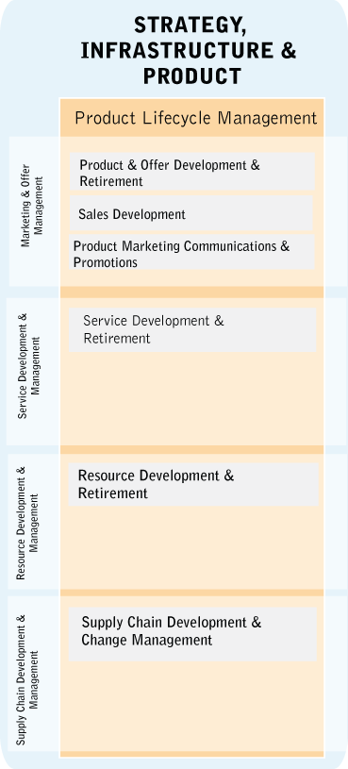
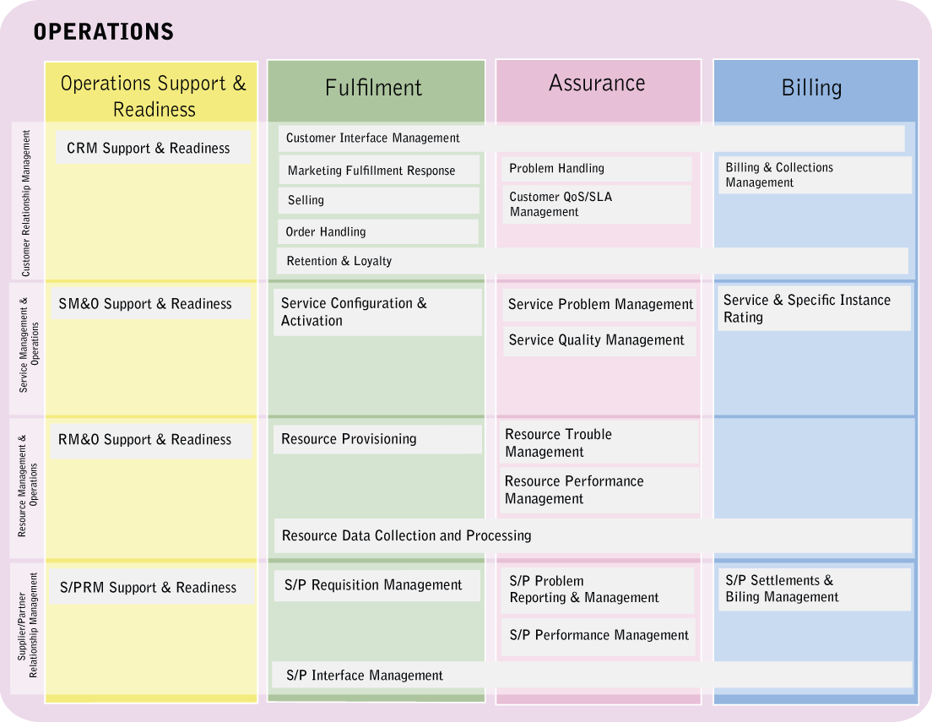
Product Catalog (portfolio and enterprise)

Slide 4
Mapping Customer Information Hub

Slide 5
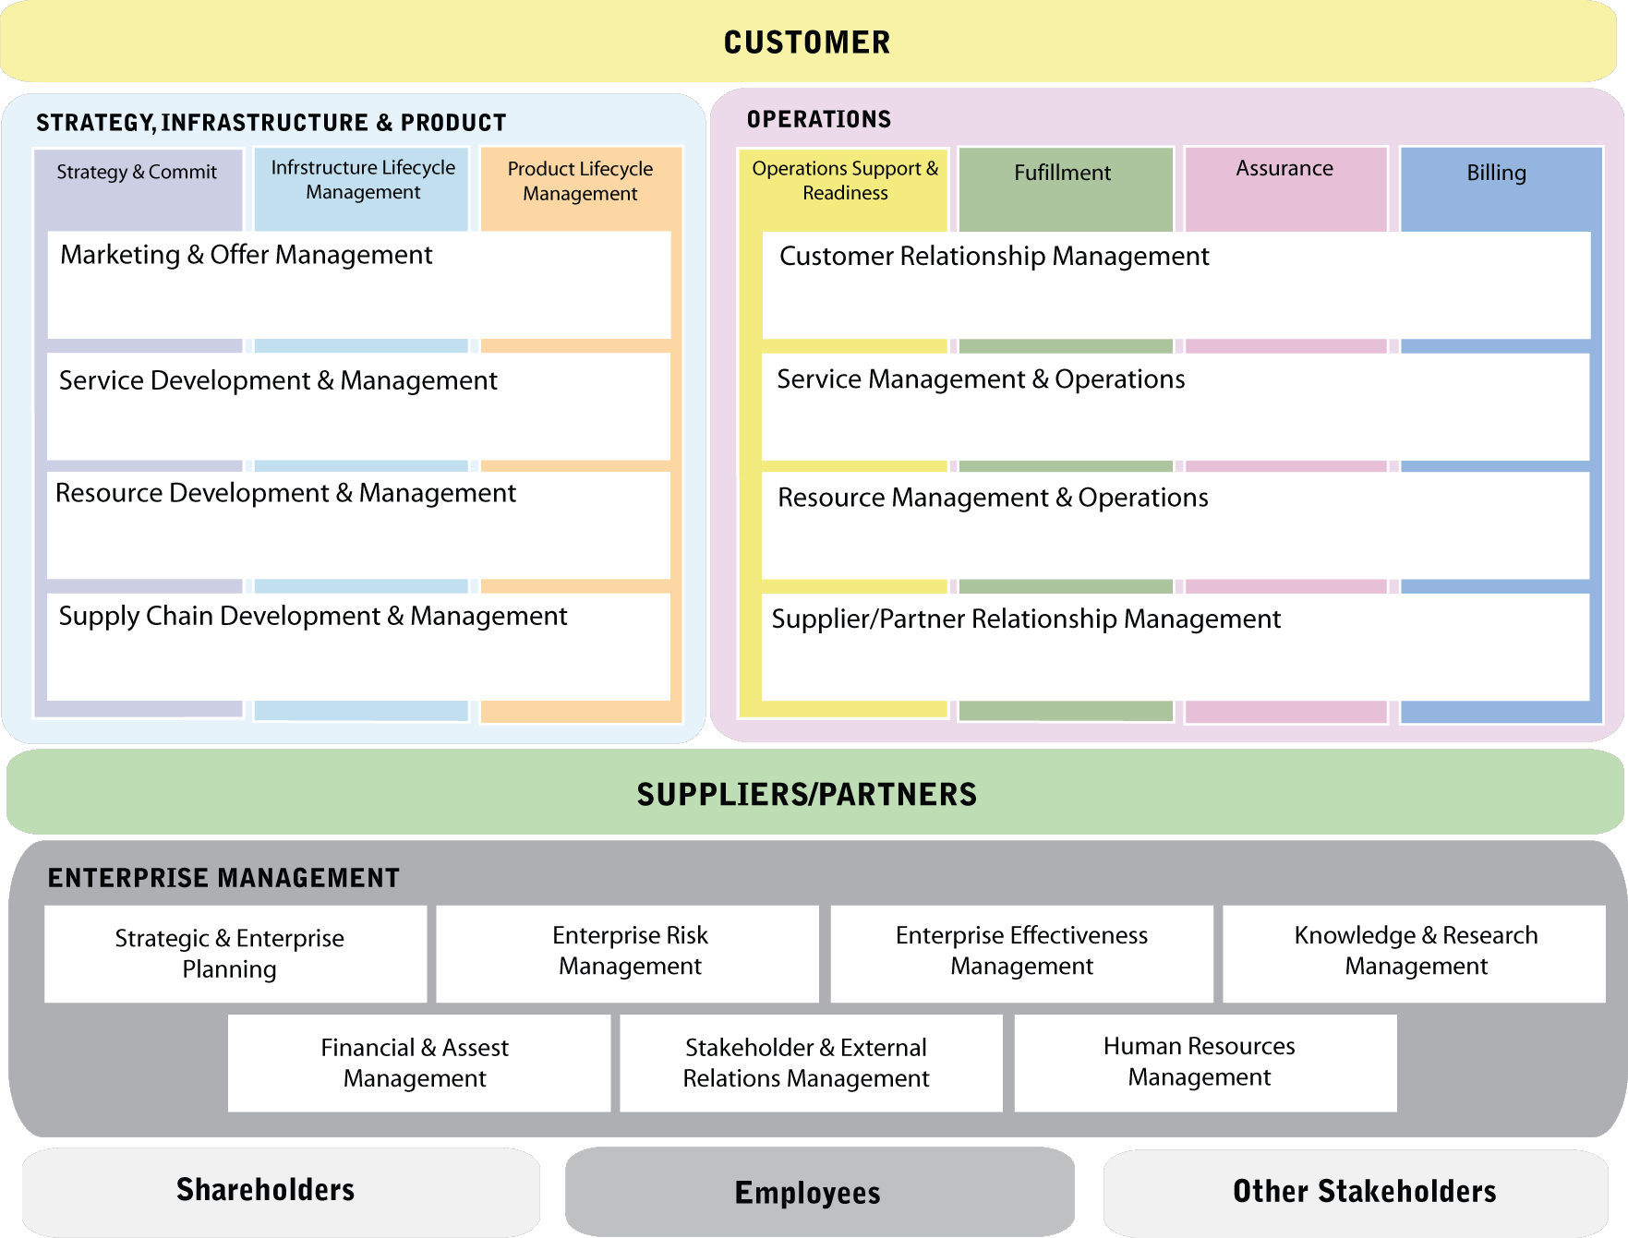
Amdocs Security Manager
Notes:
eTOM provides the Business View for NGOSS
Resume of the layers with horizontal & verticals – please note that horizontals are in line with the conceptual level
i.e. Service is the union of Service Development & Management + Service Management & Operations

Slide 6
Amdocs Monitoring & Control
Notes:
eTOM provides the Business View for NGOSS
Resume of the layers with horizontal & verticals – please note that horizontals are in line with the conceptual level
i.e. Service is the union of Service Development & Management + Service Management & Operations

Slide 7
Amdocs Process Manager to
Notes:
eTOM provides the Business View for NGOSS
Resume of the layers with horizontal & verticals – please note that horizontals are in line with the conceptual level
i.e. Service is the union of Service Development & Management + Service Management & Operations

Slide 8
Amdocs System Configurator
Notes:
eTOM provides the Business View for NGOSS
Resume of the layers with horizontal & verticals – please note that horizontals are in line with the conceptual level
i.e. Service is the union of Service Development & Management + Service Management & Operations

Slide 9
Error Manager to eTOM

Slide 10
ASOM and BPI Methodology
© 2004 - Proprietary and Confidential Information of Amdocs
Foundation
Customer Mngt
    Amdocs Customer Interaction Manager
    Amdocs Script Manager
    Amdocs Ordering
    Amdocs Billing Manager
    Amdocs Support
    Amdocs Analytics Connector
    Amdocs Marketing Connector
    Amdocs Self Service Bill
    Amdocs Self Service Order
    Amdocs Self Service Support
    Amdocs Self Service Reports
    Amdocs Field Service
    Amdocs Logistics
    Amdocs Sales
Revenue Mngt
Service & Resource Mngt
Content

Slide 11
Amdocs Customer Interaction Manager

Slide 12
Amdocs Script Manager

Slide 13
Amdocs Ordering to eTOM

Slide 14
Amdocs Billing Manager

Slide 15
Amdocs Support

Slide 16
Amdocs Analytics Connector

Slide 17
Amdocs Marketing Connector

Slide 18
Amdocs Self Service Bill

Slide 19
Amdocs Self Service Order

Slide 20
Amdocs Self Service Support

Slide 21
Amdocs Self Service Reports

Slide 22
Amdocs Field Service

Slide 23
Amdocs Logistics

Slide 24
Amdocs Sales

Slide 25
ASOM and BPI Methodology
© 2004 - Proprietary and Confidential Information of Amdocs
Foundation
Customer Mngt
Revenue Mngt
    Amdocs Charging
    Mediation
    Partner Manager
    Next Generation Convergent Billing Solution
    Account Receivable
    Collection
    Document Designer
    Subscriber Resource Manager
    Voucher manager
    Replenishment
    Balance manager
    Error Manager
    Partner Manager
    Fraud
Service & Resource Mngt
Content

Slide 26
Amdocs Charging

Slide 27
Amdocs Mediation

Slide 28
Amdocs Partner Manager

Slide 29
Next Generation Convergent Billing Solution

Slide 30
Accounts Receivable

Slide 31
Amdocs Collections

Slide 32
Document Designer

Slide 33
Subscriber Resource Manager

Slide 34
Voucher Manager

Slide 35
Replenishment Manager

Slide 36
Balance Manager

Slide 37
Error Manager

Slide 38
Fraud
Notes:
eTOM provides the Business View for NGOSS
Resume of the layers with horizontal & verticals – please note that horizontals are in line with the conceptual level
i.e. Service is the union of Service Development & Management + Service Management & Operations

Slide 39
ASOM and BPI Methodology
© 2004 - Proprietary and Confidential Information of Amdocs
Foundation
Customer Mngt
Revenue Mngt
Service & Resources Mngt
    B/OSS Manager
    Amdocs Service Order Manager
    Amdocs Support
    Amdocs SLA Manager …
    Amdocs Unified Service Manager
    Amdocs Service Catalog
    Amdocs Change Manager
    Amdocs Field Service
    Amdocs Logistics
    Amdocs Activation offering
    Cramer Resource Manager
    Cramer Task Engine
    Cramer Delivery Engine
    Cramer Sync Engine
    Cramer Discovery Engine
Content

Slide 40
Amdocs B/OSS Manager

Slide 41
Amdocs Service Order Manager

Slide 42
Amdocs Support

Slide 43
Amdocs SLA Manager

Slide 44
Amdocs Unified Service Manager

Slide 45
Amdocs Service Catalog

Slide 46
Amdocs Change Manager

Slide 47
Amdocs Field Service

Slide 48
Amdocs Logistics

Slide 49
Amdocs Activation offering

Slide 50
Cramer Resource Manager

Slide 51
Cramer Task Engine

Slide 52
Cramer Delivery Engine

Slide 53
Cramer Sync Engine

Slide 54
Cramer Discovery Engine

